Slide 1
sHEMO: Smartphone Spectroscopy for Blood Hemoglobin Level Monitoring in Smart Anemia-care
Sagnik Ghosal

Slide 2
Outline
Introduction
Problem Statement
Novelty and Contribution
Proposed sHEMO Model
Experimental Results and Discussions
Future Research Scope
References

Slide 3
Introduction
Anemia is the condition of a dearth of Red Blood Cells (RBC).
It is characterised by a low blood hemoglobin level.
Worldwide it has affected over 1.9 billion people.
Anemia detection falls into two broad categories: Invasive and Non-Invasive.
Major drawbacks of Invasive techniques are cost, high time complexity and are very painful.
Drawbacks of existing Non-Invasive techniques include, lacking ability of smartphone implementation, using additional resources with smartphone, explicitly defining the area of the ROI, non-autonomous ROI extraction and lack of simultaneous hemoglobin quantification and Anemia screening.
Conjunctival pallor is mostly selected as the ROI, because it provides more accurate results compared to other regions such as finger-nail bed and tongue.

Slide 4
Problem Statement
The Shortcomings:
The 4 major problems in the existing Non-Invasive anemia detection are:
ROI extraction performed in a non-autonomous fashion
Lack of smartphone incorporation or requiring additional equipment even if smartphone implementation is made possible
Lack of quantifying blood hemoglobin level and simultaneously screen anemia
Lack of accuracy when trying to make up for the previous shortcomings
Problem Definition:
Therefore the necessity for a model which predicts blood hemoglobin level as well as the anemic state of the patient, by autonomous method of ROI extraction, to a very high accuracy and involving only a smartphone, arises.

Slide 5
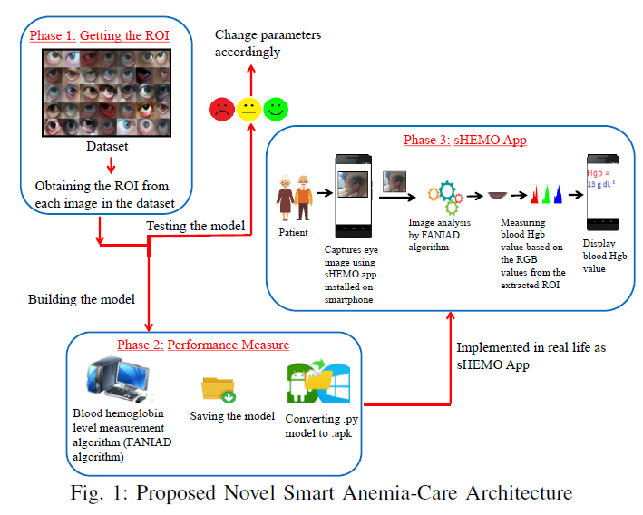
Novelty and Contribution
sHEMO model is proposed
It is a novel, non-invasive method of blood hemoglobin measurement and anemia screening.
Extracts the ROI region autonomously from the captured eye image.
Extracts the most appropriate regions from the ROI for hemoglobin measurement without user interference.
Developed using image processing techniques and therefore can be easily smartphone implemented without the necessity of additional equipment.
Achieved a very high accuracy both in hemoglobin level prediction and anemia screening.
A three-phase pipelined smart anemia-care architecture is also developed:

Slide 6
Proposed sHEMO Model
sHEMO is divided into 3 phases:
Extracting the ROI from the image
Performance measure
Implementation in the form of sHEMO app for smartphone
Phase 1 and 2 together constitute the FANIAD algorithm (Fully Autonomous Non-Invasive Anemia Detection)
Phase 1 is subdivided into 5 categories:
Eye Detection
Eye Centre Detection
Eye Image Reduction
Modified Canny Edge Detection
Masking and Image Subtraction
Phase 2 is subdivided into 3 categories:
Selection of Best Instances from ROI
Blood Hemoglobin calculation
Anemia Screening

Slide 7
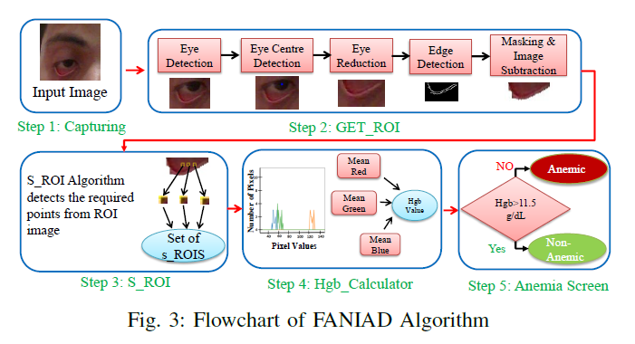
Proposed sHEMO Model
Step 1 captures the image using a smartphone camera or webcam and feeds it to the subsequent stages.
Step 2 named as GET_ROI is a function which is called to extract the region of interest from the captured image.
Step 3 named as S_ROI is a function which is called to extract the best instances from the ROI image.
Step 4 named as Hgb_Calculator is a function which is called to calculate the Hgb level.

Slide 8
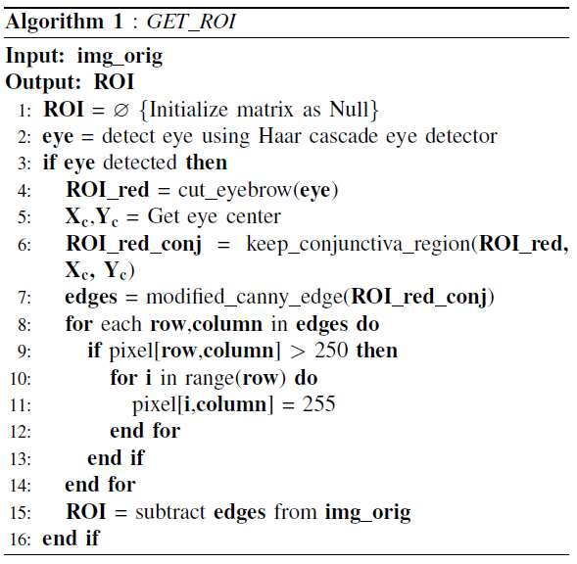
Proposed sHEMO Model (Phase 1: GET_ROI)
The Eye Detection is performed with the help of Haar cascade eye detector (line 2). Haar cascade is a technique in which a cascade function trained using large number of positive and negative images, are used to identify that object from other images.
For the Eye Centre Detection, BLOB detection technique has been used (line 4-5). 25% of the eye image has been reduced from the top, to remove the redundant eyebrow regions. After this, a Thresh is used, such that every pixel above it is converted into white and below it into black. Image processing techniques such as eroding, dilation and median blurring are used to form a contour around the detected black region. The concept of image moment is then used to obtain the center of the contour.

Slide 9
Proposed sHEMO Model (Phase 1: GET_ROI)
The Eye Image Reduction keeps only the part closest to the conjunctival pallor by removing everything above a limit (line 6). This limit is present vertically 3.5 mm from the center of the eye.
A major disadvantage of simple Canny edge detection is the varying thresholds of lower and upper limits for different images. Modified Canny edge detection is used, which calculates the lower and upper limits based on standard deviation σ and 95% CI (line 7). A very low value of σ results in a compact threshold and a very large value results in an extensive threshold.
The resulting edges are used for masking, performed by iterating the image matrix from the top left corner and filling entire column into white pixel once a white pixel is encountered (line 8 – 14). After completion the mask is subtracted from the original eye image to get the ROI (line 15).

Slide 10
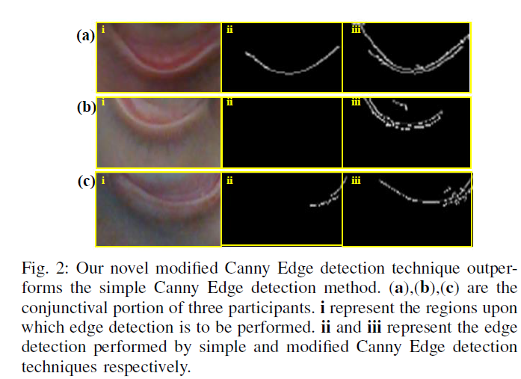
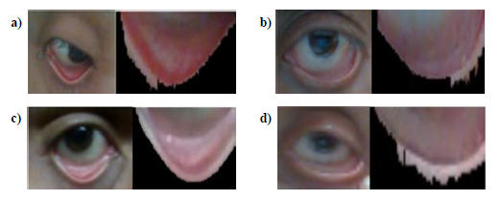
Proposed sHEMO Model (Phase 1: GET_ROI)

Slide 11
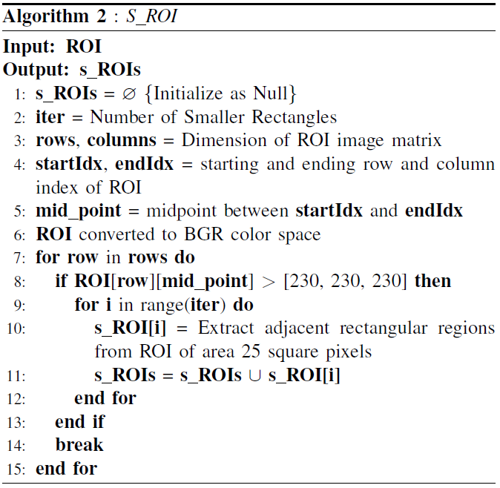
Proposed sHEMO Model (Phase 2: S_ROI)
The best instances are located in the lowermost position of the ROI. These regions remain least affected to lighting.
The starting index (startIdx), ending index (endIdx) and midpoint index (mid_point) for the colored portion of ROI is calculated (line 3 – 5).
Along the midpoint index column the lowest row is reached and then from few rows just above it, rectangles of area 25 square pixels are extracted horizontally (line 7 – 10).
All these small rectangles are stored in a list, which is returned at the end of function definition (line 11).

Slide 12
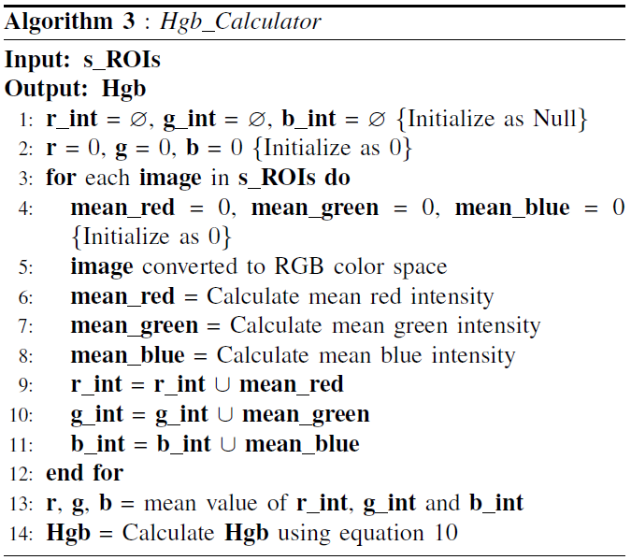
Proposed sHEMO Model (Phase 3: Hgb_Calculator)
Histograms showing the RGB values for each of the best instances are plotted and the mean RGB values are calculated from it (line 3 – 13).
Based on a logistic regression formula, the Hgb value is obtained. The regression formula takes in the mean RGB values as input.
Since the formula used is a regression formula, the need to change the parameters for an optimum value arises. Therefore the predicted values are compared with the actual values and the best regression formula is developed.
Once the ideal equation has been established, the hemoglobin values are quantified.

Slide 13
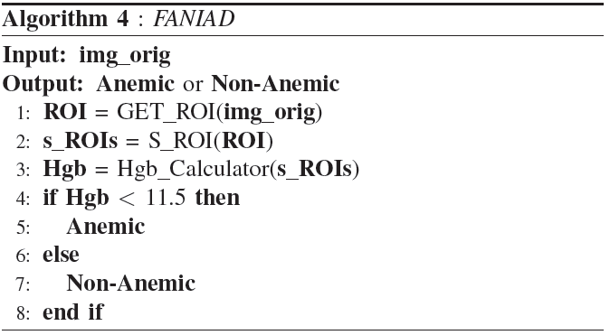
Proposed sHEMO Model (Phase 2: Anemia Screening)
Based on the obtained hemoglobin value from the previous step, anemia screening is performed.
Clinically Hgb values < 11.5 g/dL are considered low and anemic. We have therefore used this threshold for anemia screening.
If predicted Hgb value is less than the threshold, the patient is termed anemic else non-anemic.
All the previous functions are agglomerated into a single algorithm called FANIAD (Algorithm 4).

Slide 14
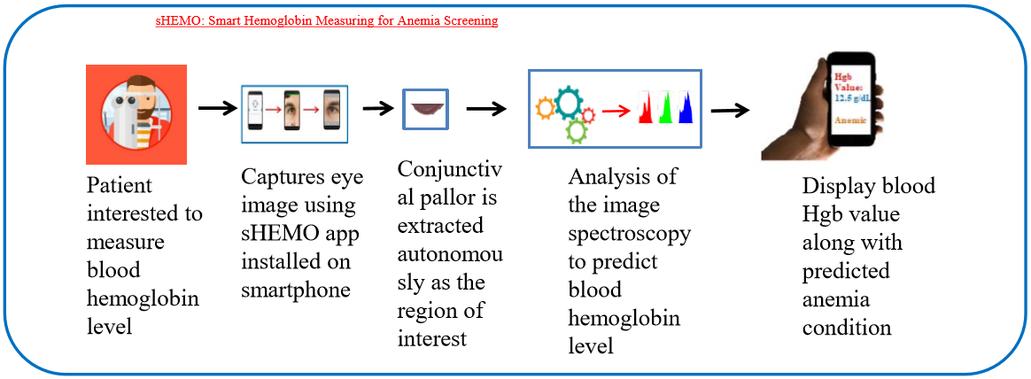
Proposed sHEMO Model (Phase 3: sHEMO App)
The sHEMO model gets implemented as a smartphone based application.
A patient who wants to know his/her blood hemoglobin value needs to download the app on the smartphone and capture an eye image.
The captured eye image is processed by the .apk file on the app to first display the auto extracted conjunctival pallor as the region of interest, and then after analyzing the RGB values of that region, an accurate prediction about the blood hemoglobin level is made

Slide 15
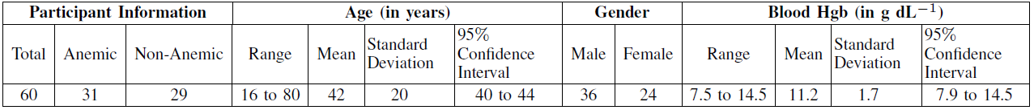
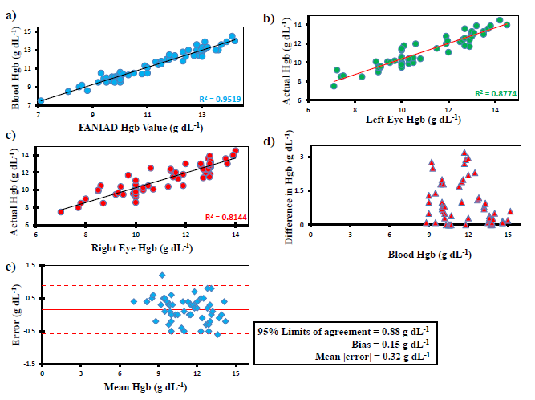
Experimental Results and Discussions
Data Set Used:
Results:
FANIAD algorithm accurately measures blood Hgb levels.
a) The solid line indicates the actual data fit between predicted Hgb level and clinically measured Hgb level. High correlations are observed between them with R2=0.9519. b) High correlations between measured left eye Hgb value by FANIAD and clinical laboratory tests, with R2=0.8774. c) High correlations between measured
right eye Hgb value by FANIAD and clinical laboratory tests, with R2=0.8144. d) Structured comparison between measured Hgb level difference between left and right eye and the actual blood Hgb level (mean difference = 0.86 g/dL). e) Bland–Altman analysis illustrates that the Hgb measurement performed by FANIAD has a minimal experimental bias of 0.15 g/dL and narrow 95% limits of agreement (LOA) of [-0.58, 0.88 g/dL]. The solid red line indicates bias (0.15 g/dL) while dashed red lines represent 95% limits of agreement [-0.58, 0.88 g/dL].

Slide 16
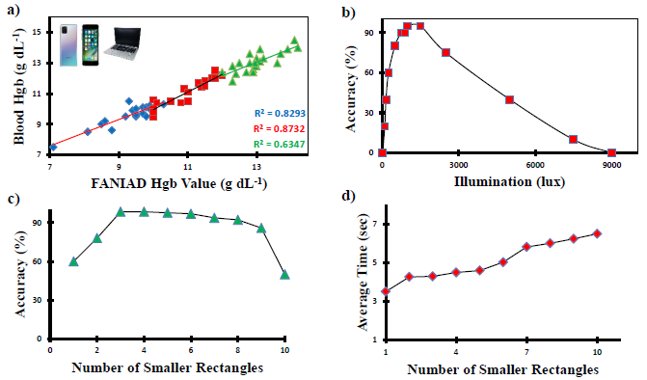
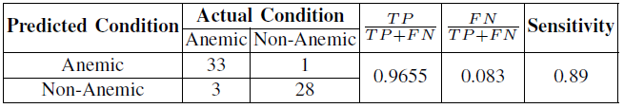
Experimental Results and Discussions
Results:
a) FANIAD predicts blood hemoglobin level accurately for different devices. b) FANIAD remains robust to a wide range of illumination, with respect to accuracy. c) The accuracy of FANIAD varies with the selection of number of smaller rectangles. d) With the increase in consideration of number of smaller rectangles the computational time also increases.

Slide 17
Future Research Scope
Assessment on a larger dataset is likely to improve the model’s accuracy further.
The concept of autonomous ROI extraction can be utilized to extract fingernail beds in parallel with the conjunctival pallor, and then measure the blood hemoglobin level using both the regions.
For a more accurate prediction, clustering algorithms such as the K-means can be used to correlate the conjunctival pallor color and Hgb level.
Also, the prospect of implementing neural networks using smartphones, in collaboration with image processing, can be explored.

Slide 18
References
P. Viola and M. J. Jones, “Robust real-time face detection,” International journal of computer vision, vol. 57, no. 2, pp. 137–154, 2004.
S. Filonov, “Tracking your eyes with python,” Available:https://medium.com/@stepanfilonov/tracking-your-eyes-with-python-3952e66194a6,2019.
W. A. van den Bosch, I. Leenders, and P. Mulder, “Topographic anatomy of the eyelids, and the effects of sex and age,” British journal of ophthalmology, vol. 83, no. 3, pp. 347–352, 1999.
D. A. Nardone, K. M. Roth, D. J. Mazur, and J. H. McAfee, “Usefulness of physical examination in detecting the presence or absence of anemia,” Archives of internal medicine, vol. 150, no. 1, pp. 201–204, 1990.
J. Canny, “A computational approach to edge detection,” IEEE Transactions on pattern analysis and machine intelligence, no. 6, pp. 679–698, 1986.
S. AlZahir and H. Donker, “A novel regression based model for detecting anemia using color microscopic blood images,” Journal of Software Engineering and Applications, vol. 3, no. 8, p. 756, 2010.

